Slide 1
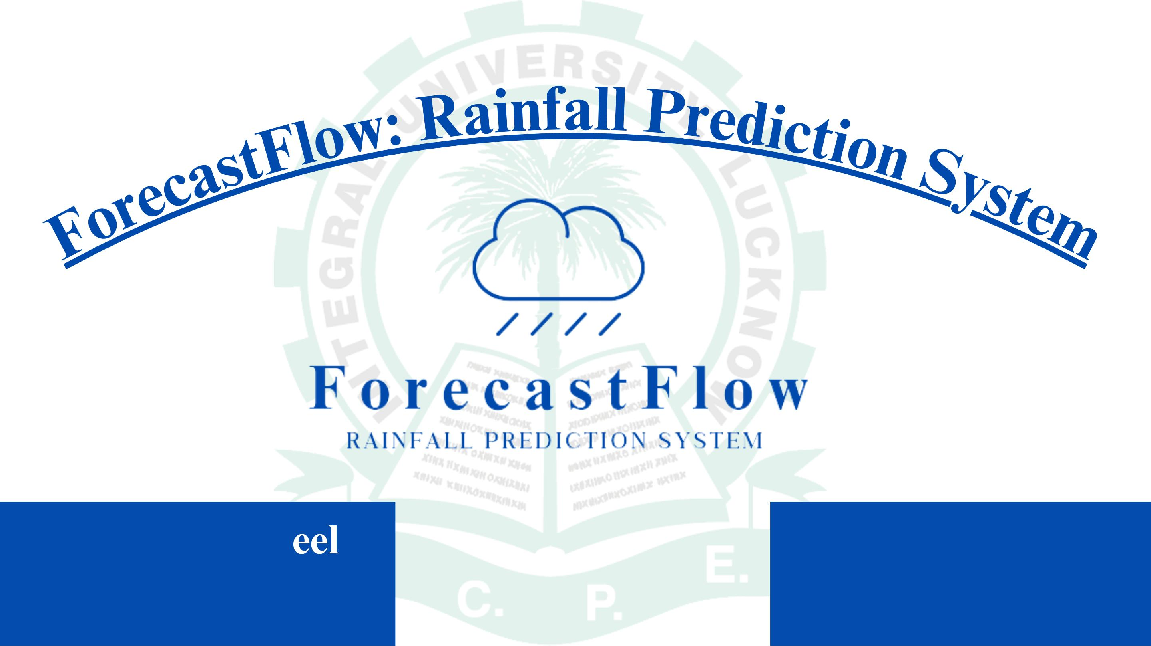
INTEGRAL UNIVERSITY, LUCKNOW
Al Saim Shak
Supervised by
Ahtisham Riyasat
Mr. Aftaab Ala

Slide 2
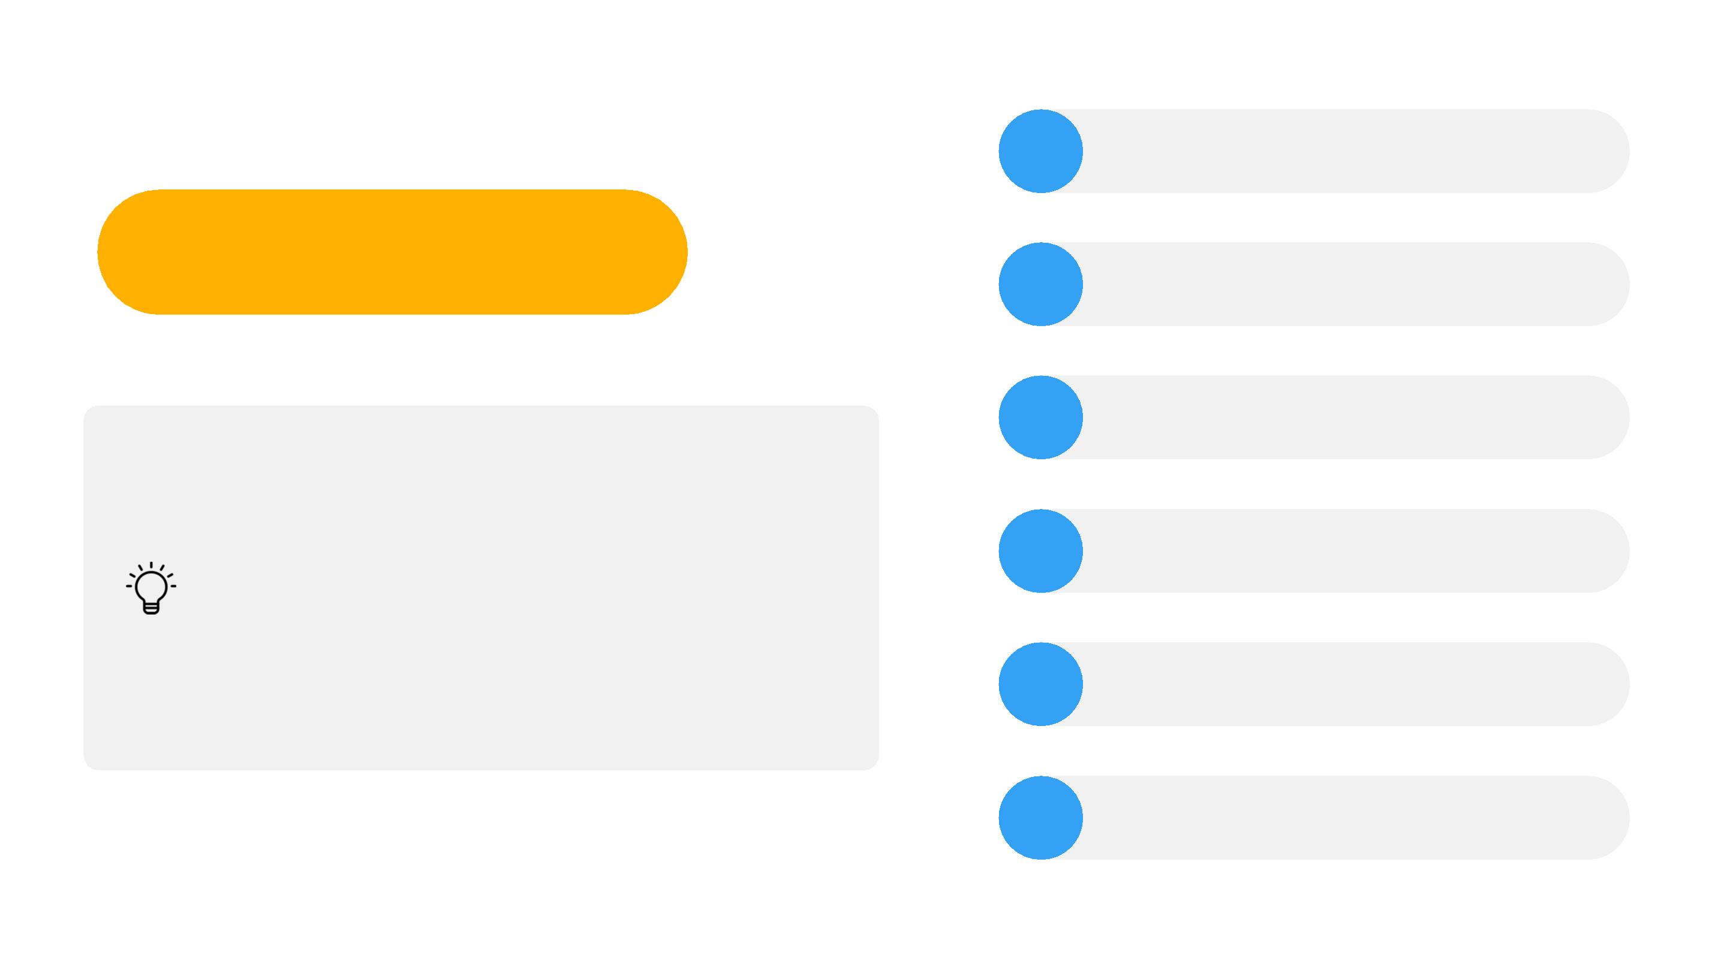
1
Reading Dataset
Data Preprocessing
Undersampling
Splitting DATA
MODELING
Introduction
2
3
5
6
7
Rainfall Prediction: System Enhancing Next-Day
Forecasting in Australia
Project Overview: Development of a predictive
system for next-day rainfall in Australia.
Objective: Provide accurate forecasts and quantify
the probability of rainfall.
Conclusion

Slide 3

Reading Dataset
Date: The date of observation
Location: The common name of the location of the weather station
MinTemp: The minimum temperature in degrees celsius
49
MaxTemp: The maximum temperature in degrees celsius
Rainfall: The amount of rainfall recorded for the day in mm
Evaporation: The so-called Class A pan evaporation (mm)
Sunshine: The number of hours of bright sunshine in the day.
WindGustDir: The direction of the strongest wind gust in the 24 hours to midnight
WindGustSpeed: The speed (km/h) of the strongest wind gust in the 24 hours to midnight
WindDir9am: Direction of the wind at 9am
2008-2017
WindDir3pm: Direction of the wind at 3pm
WindSpeed9am: Wind speed (km/hr) averaged over 10 minutes prior to 9am.
Humidity9am: Humidity (percent) at 9am
Humidity3pm: Humidity (percent) at 3pm
145459 rows
Pressure9am: Atmospheric pressure (hpa) reduced to mean sea level at 9am
Pressure3pm: Atmospheric pressure (hpa) reduced to mean sea level at 3pm
Cloud9am: Fraction of sky obscured by cloud at 9am. This is measured in "oktas", which are a unit of eigths. It records how many
Cloud3pm: Fraction of sky obscured by cloud (in "oktas": eighths) at 3pm. See Cload9am for a description of the values
Temp9am: Temperature (degrees C) at 9am
Temp3pm: Temperature (degrees C) at 3pm
RainToday Boolean: 1 if precipitation (mm) in the 24 hours to 9am exceeds 1mm, otherwise 0
RainTomorrow: The amount of next day rain in mm. Used to create response variable RainTomorrow. A kind of measure of the "risk".
BACK TO INTRODUCTION PAGE

Slide 4
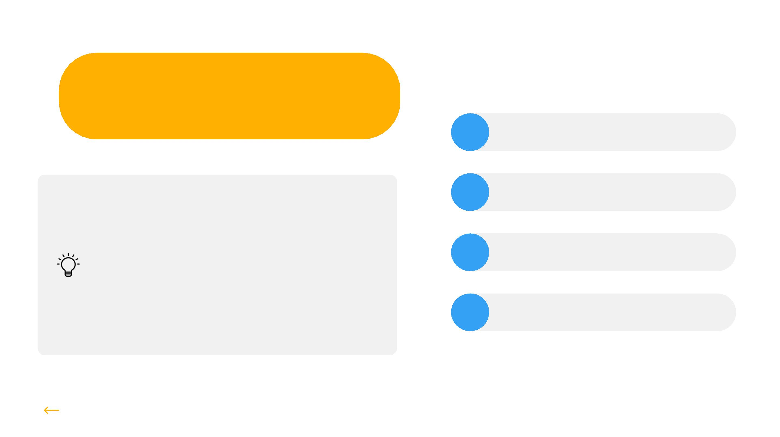
Data Preprocessing
1 Data Cleaning
Data preprocessing in data
science refers to the cleaning,
transforming, and organizing of
raw data into a format suitable
for data analysis and Machine
Learning.
2 Handling Null Values
3 Handling Duplicates Recored
5 Label Encoding
BACK TO READING DATA SET

Slide 5
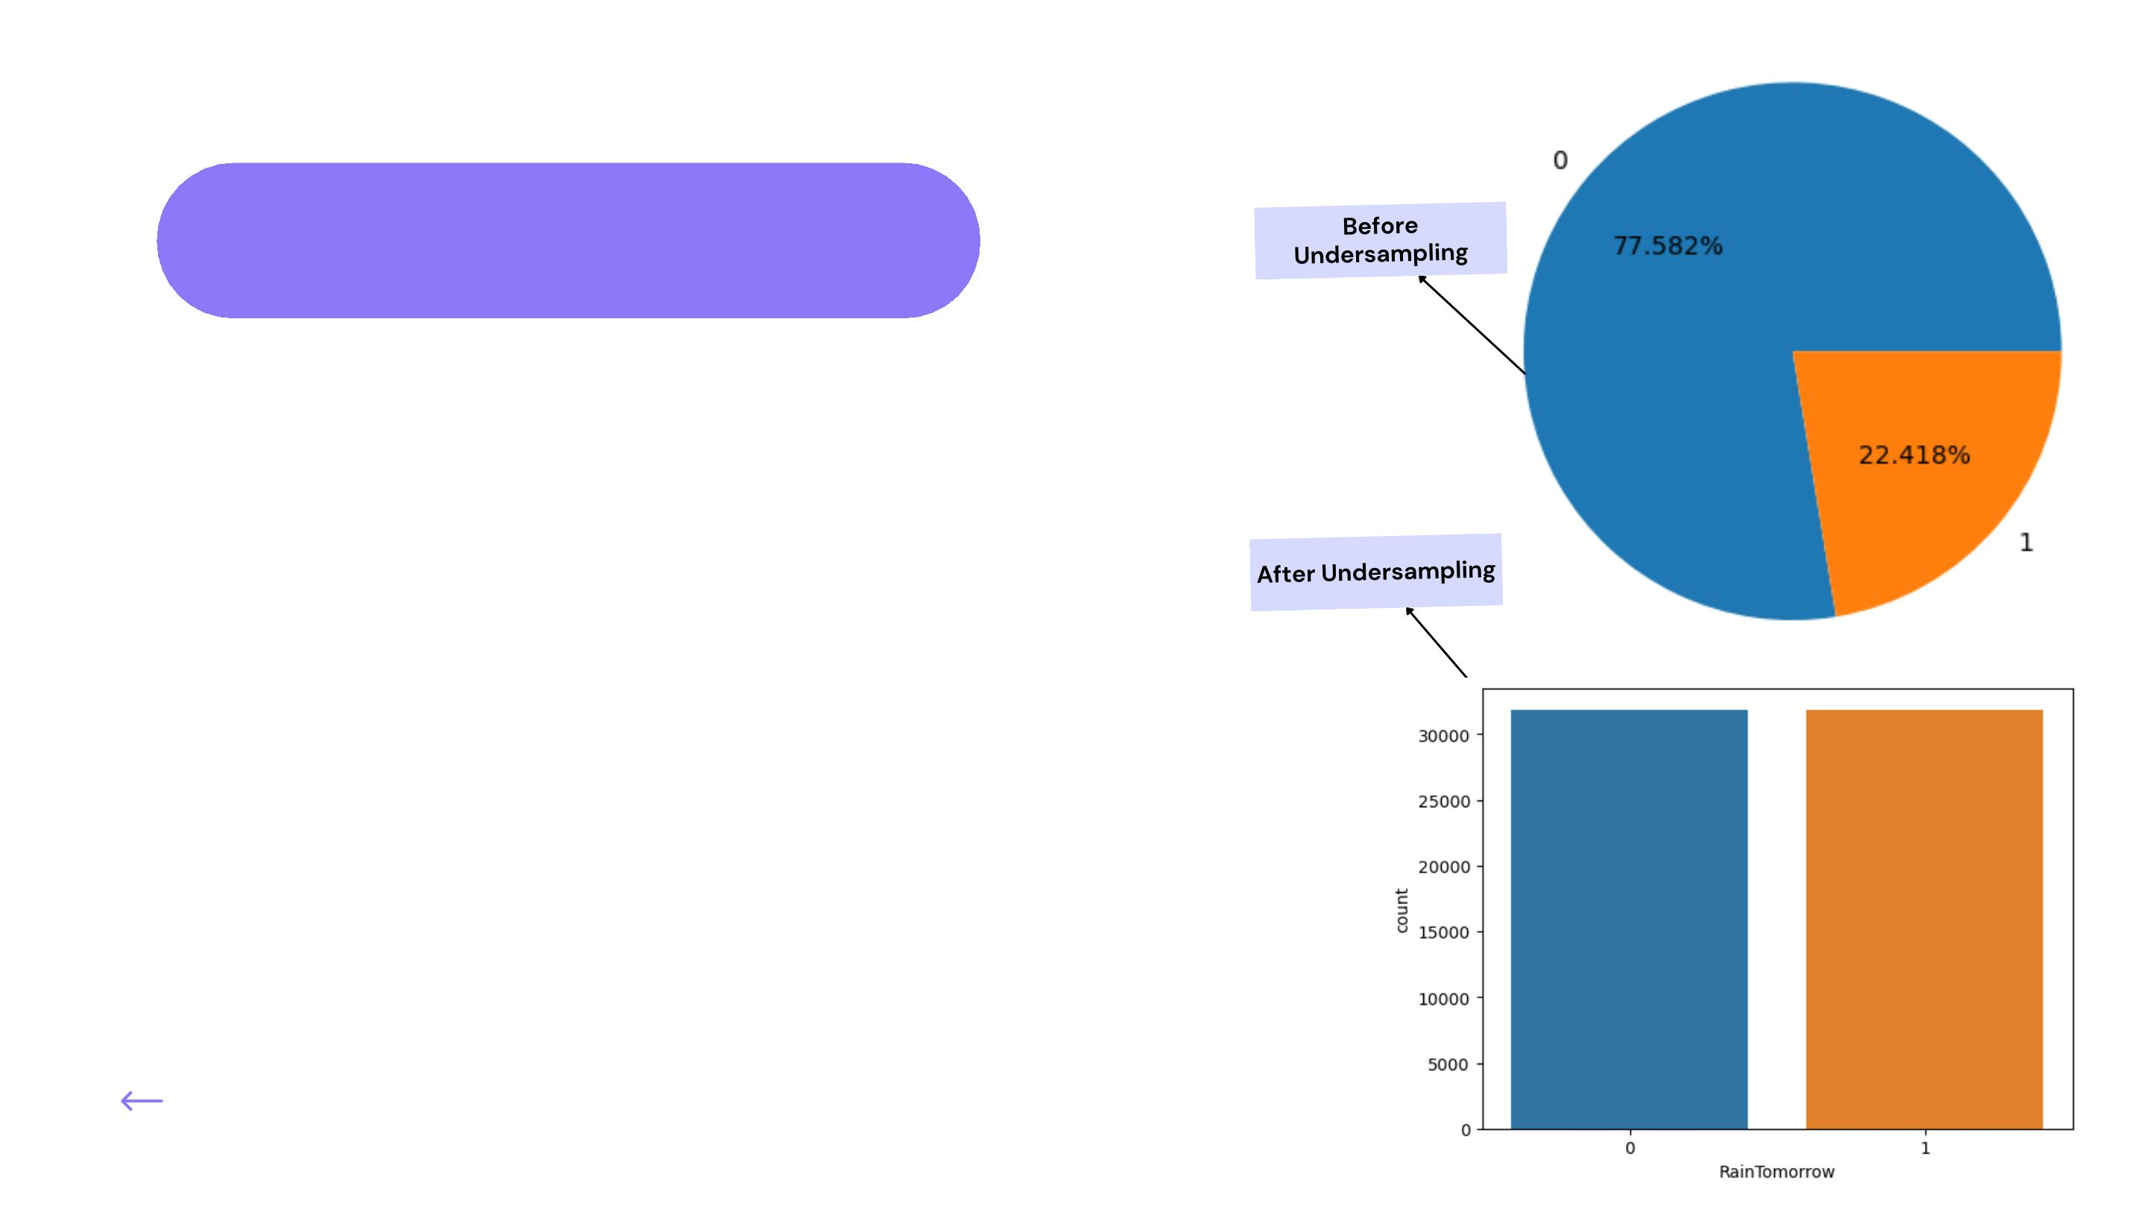
Undersampling
Given the observed imbalance in our dataset, we will
employ undersampling techniques to achieve
balance. This approach is particularly suitable
considering the substantial size of our dataset.
Upon implementing undersampling, we have achieved
an equal distribution of the categories "No" (0) and
"Yes" (1), each with a count of 31,877. This results in a
balanced dataset comprising 63,754 rows and 23
columns, which is a substantial size for our analysis.
BACK TO DATA PREPROCESSING

Slide 6

Splitting DATA
OUR CODE SPLITS DATA INTO TRAINING
AND TESTING SETS, AND THEIR SHAPES
ARE:
This code splits your data (`x` and `y`) into
training and testing sets
(`x_train`, `x_test`, `y_train`, `y_test`).
X_TRAIN.SHAPE: (42715, 20)
X_TEST.SHAPE: (21039, 20)
Y_TRAIN.SHAPE: (42715,)
Y_TEST.SHAPE: (21039,)
About 67% is used for training, and 33%
for testing. The random seed is set to 42
for reproducibility.
BACK TO UNDERSAMPLING

Slide 7
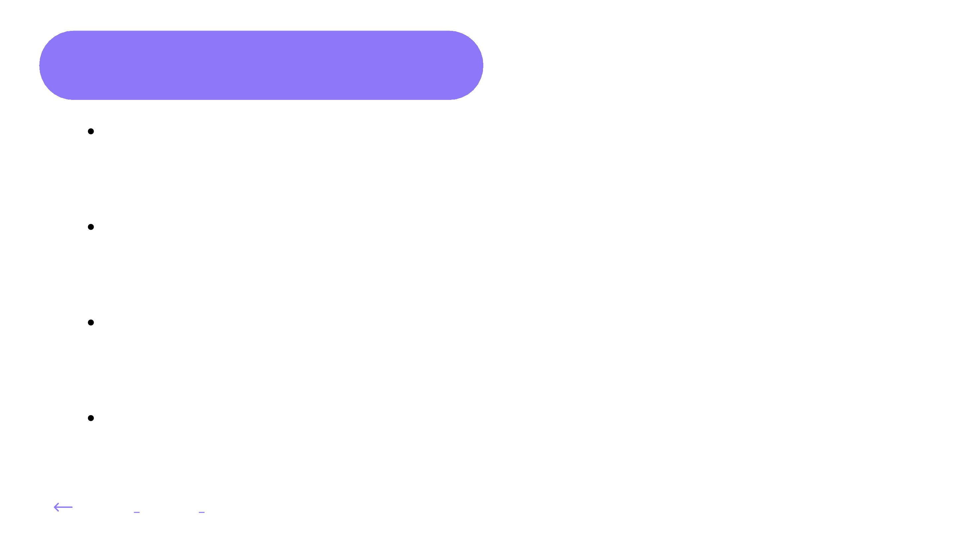
MODELING
Logistic Regression: Like deciding if it will rain tomorrow or not based on past data. It's a yes/no
prediction tool.
Example: Will it rain tomorrow? Yes or No
.K-Nearest Neighbors (KNN): Checking with nearby points to see if they experienced rain before.
More neighbors with rain, higher chance of rain tomorrow.
Example: Ask your neighbors if it rained at their place.
XGBoost (eXtreme Gradient Boosting): Combining many weak opinions (models) to form a
strong decision. Each model corrects the mistakes of the previous one.
Example: Asking multiple friends for advice and combining their answers.
Light GBM (Light Gradient Boosting Machine): Similar to XGBoost but optimized for speed. It
quickly learns from its mistakes and adjusts its approach.
Example: Learning from your mistakes and adapting quickly.
BACK TO SPLITTING DATA

Slide 8
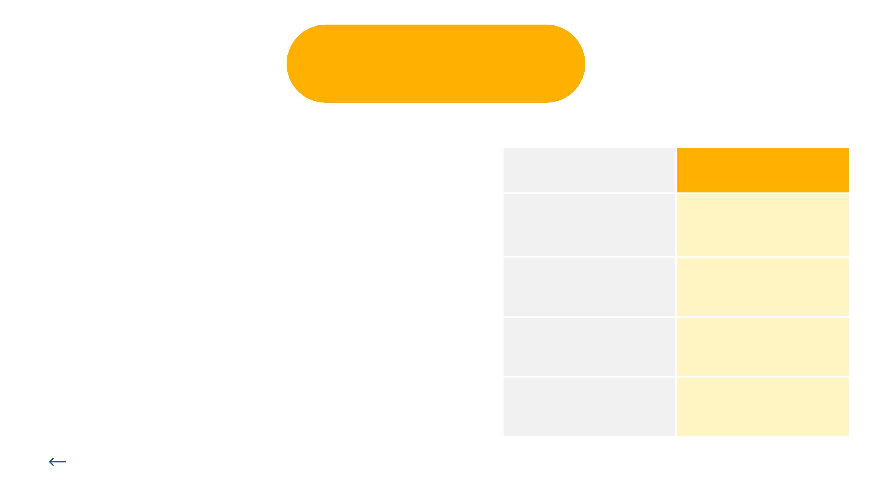
Conclusion
So we have applied total four models-->
Model Name
Accuracy (in %
The K-Nearest Neighbors (KNN) model will not be
utilized due to its comparatively lower accuracy.
Although the XGBoost model exhibits an impressive
accuracy of 80%, its training score of 99% suggests
a potential overfitting risk, thus we will refrain from
using it. The remaining models, Logistic Regression
and LightGBM, are both viable options. However,
given that LightGBM demonstrates the highest
accuracy without the risk of overfitting, we will
proceed with the LightGBM model.
KNN Model
76%
Logistic Regression
XG Boost
77%
80%
81%
Light GBM
BACK TO MODELING

Slide 9
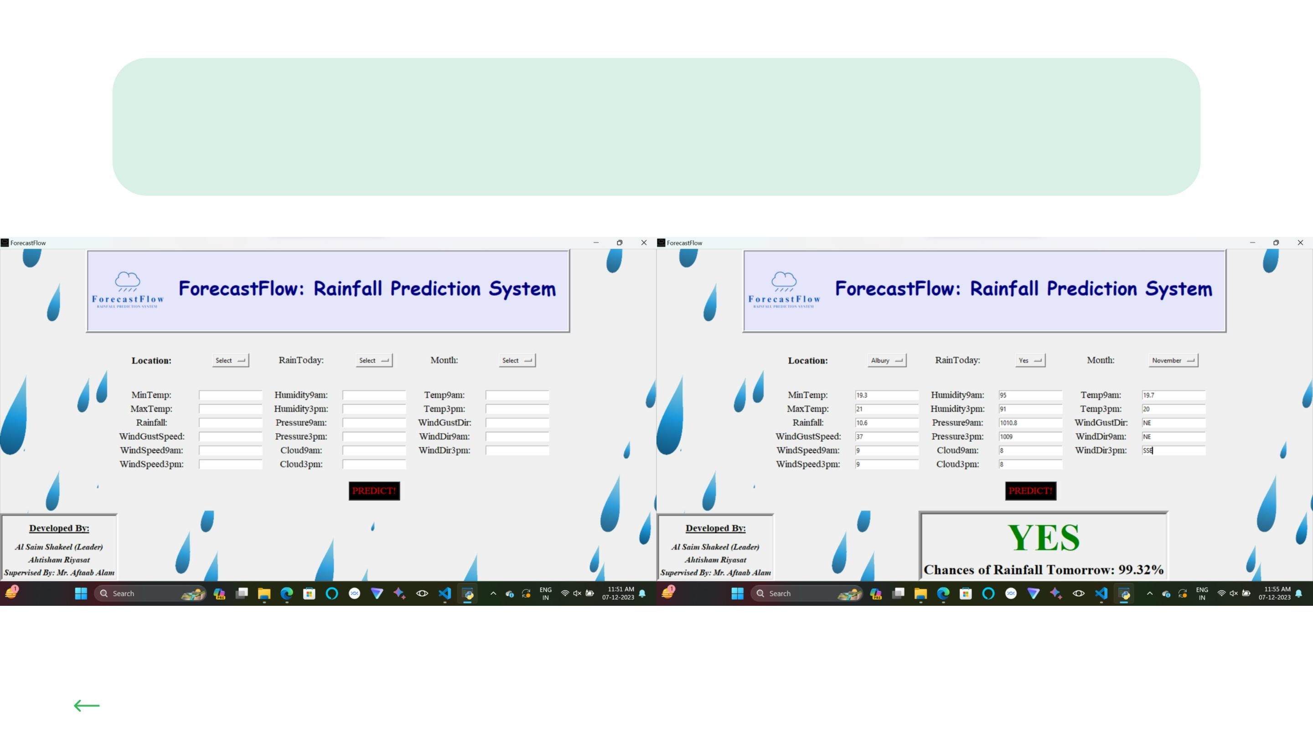
User Interface with Tkinter
BACK TO MODELING

Slide 10

THE END
THANKS
FOR
WATCHING!

